Slide 1


Toronto Major Crime Indicators (MCI) analysis

Slide 2
Project Plan:
Analyze Toronto MCI
Find the most dangerous and safest neighborhoods in Toronto
Look for correlations of MCI with:
Average Neighborhood income
Population growth
Unemployment
Average Income

Slide 3
Sources
https://www.kaggle.com/datasets/ykozlov/torontomci
Unemployment rate: https://www.statista.com/statistics/578362/unemployment-rate-canada/
Police data: http://data.torontopolice.on.ca/pages/open-data src="attachment:image.png" alt="image.png" />
Population data and analysis: see percapita.ipynb Population of toronto: https://en.wikipedia.org/wiki/Demographics_of_Toronto
For 2017: https://www.google.com/publicdata
For 2018: https://www.toronto.ca/city-government/data-research-maps/toronto-at-a-glance/
Average Income: Canadian Mortgage and Housing Company, https://www.cmhc-schl.gc.ca/en/corp/about/cahoob/data/upload/Table-17_EN_Before-Tax_w.xlsx
Neighborhoods map data https://www.toronto.ca/city-government/data-research-maps/open-data/

Slide 4
Tools Used:
HDFS
Hive
HBase
Spark (Zeppelin Notebook)
Pig

Slide 5
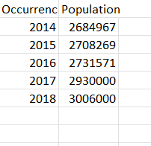
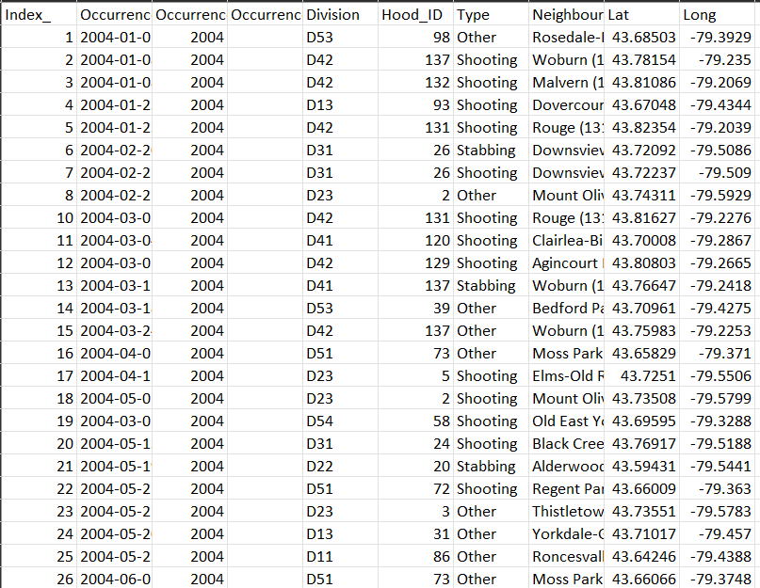
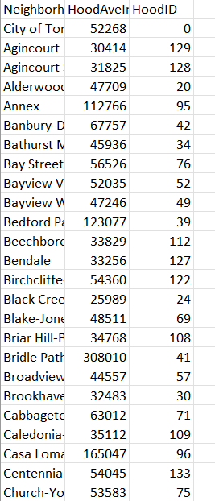
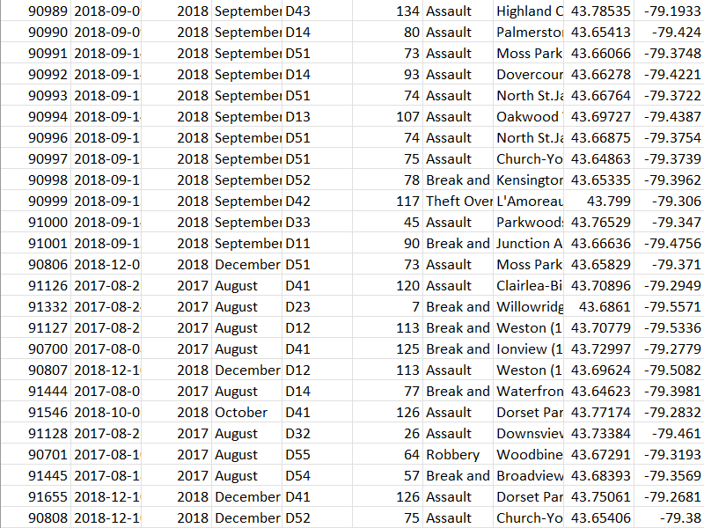
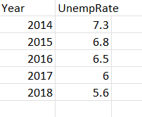
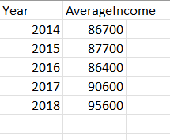
Datasets

Slide 6
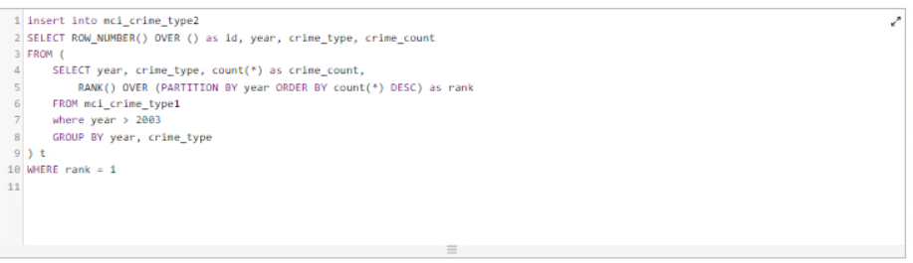
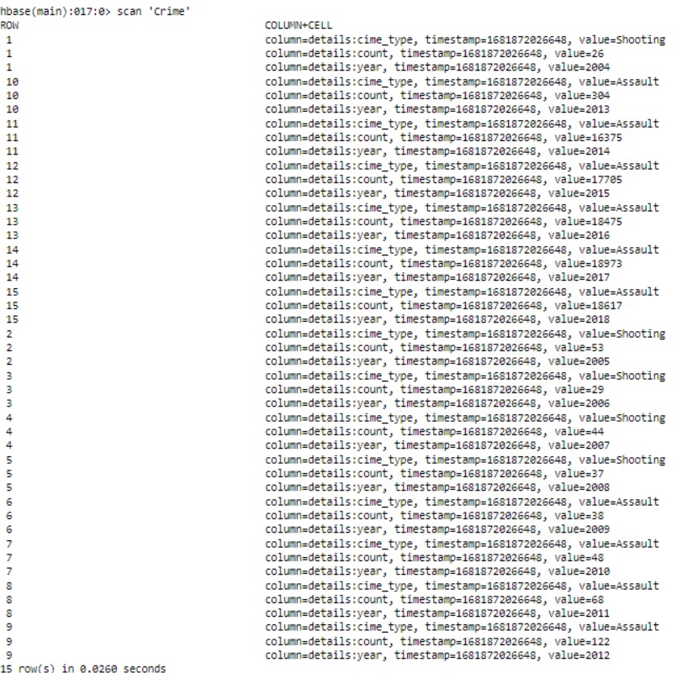
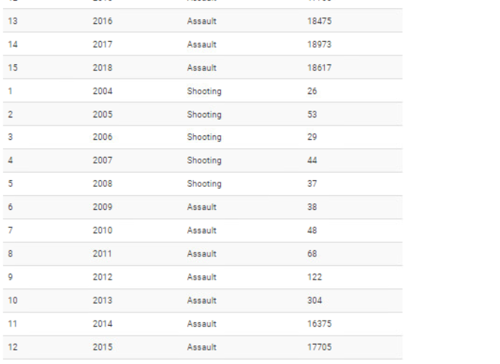
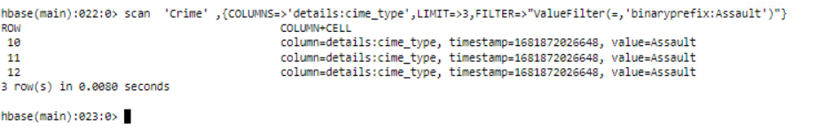
DATA Analysis Using HIVE and STORING IN HBase

Slide 7

MCI and Average Neighbourhood Income

Slide 8
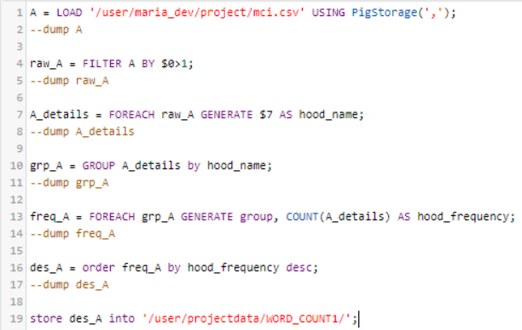
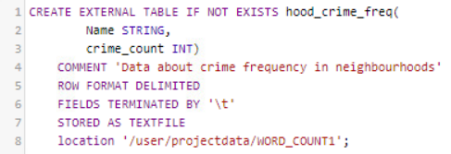
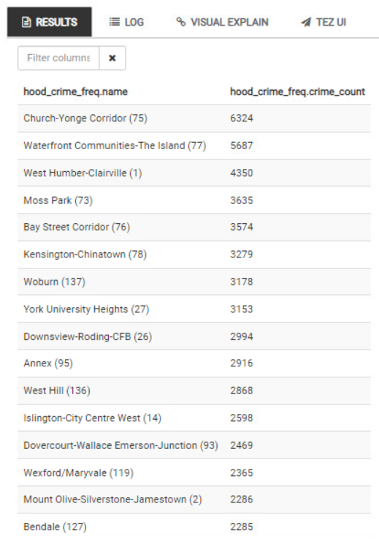
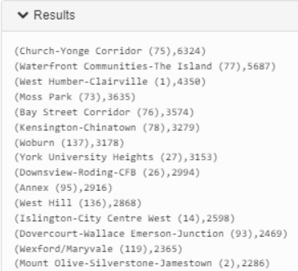
Counting the frequency of crimes in every neighborhood using Pig and storing result in a hive table

Slide 9
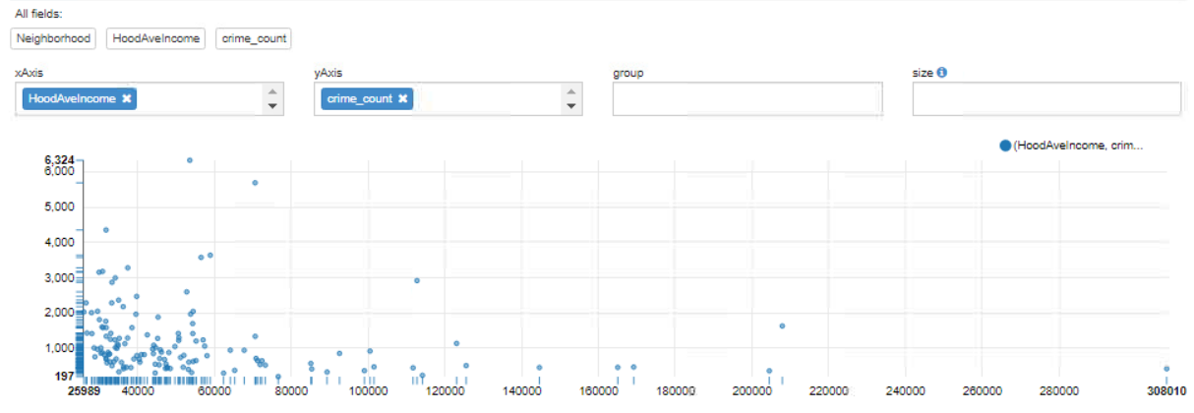
Most of the neighborhoods have average income less than 60000.
The crime rate is very high in neighborhoods with less average income compared to neighborhoods with high average income.

Slide 10
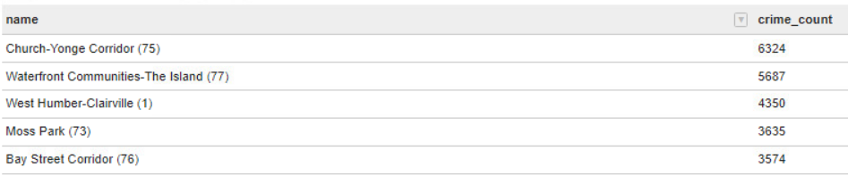
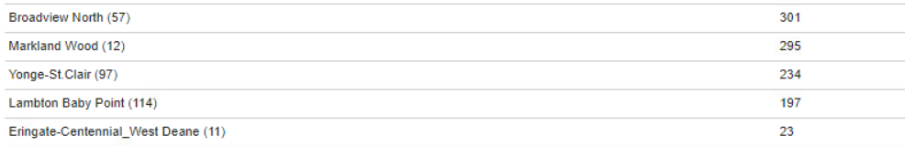
Safest and Dangerous Neighborhoods
Top 5 Dangerous Neighborhoods
Top 5 Safest Neighborhoods

Slide 11


MCI and Population Growth

Slide 12
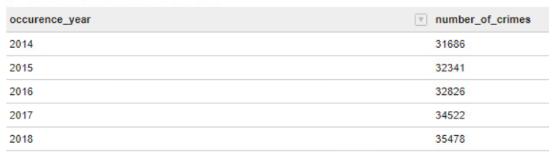
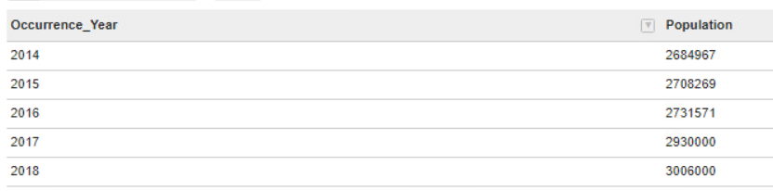
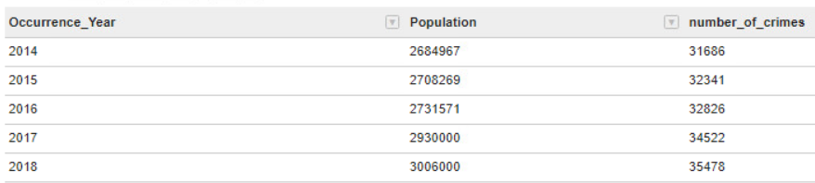
Table from Hive
Population View
Joined Table

Slide 13
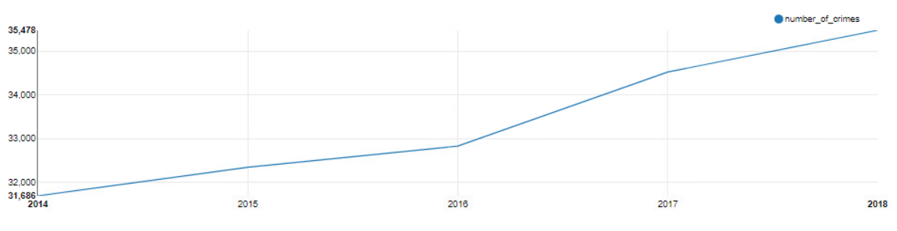
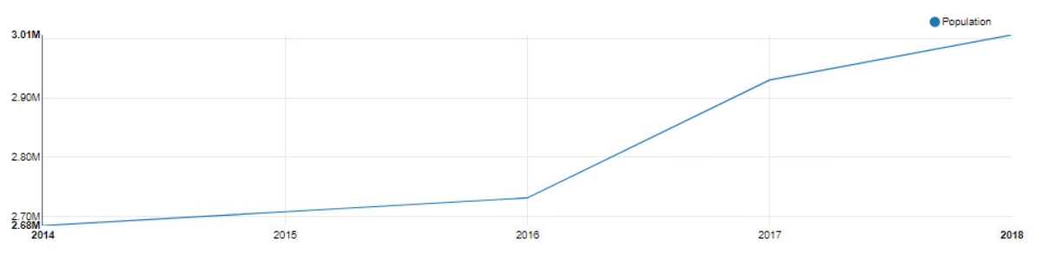
From the Line Graphs, it is clearly visible that as population increased, number of crimes also increased each year.
Number of Crimes vs Year
Population Growth vs Year

Slide 14

MCI and Unemployment Rate

Slide 15
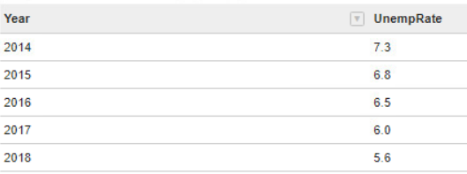
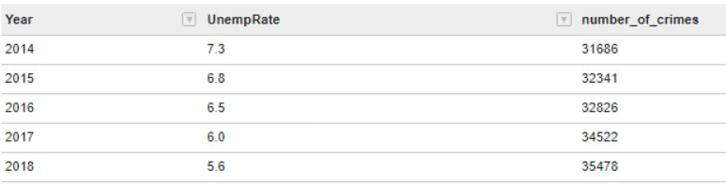
Table from Hive
Unemployment Rate View
Joined Table

Slide 16
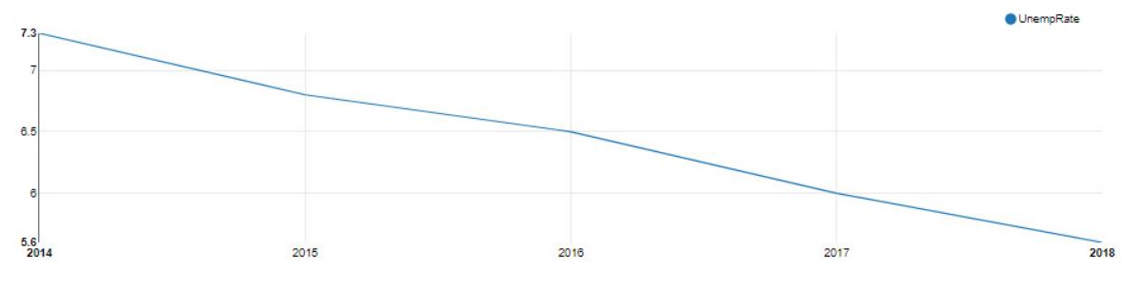
From the Line Graphs, it is clearly visible that as unemployment decreased, number of crimes increased.
Number of Crimes vs Year
Unemployment Rate vs Year

Slide 17
MCI and Average Income

Slide 18
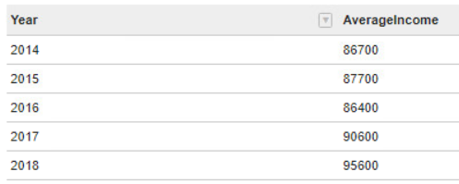
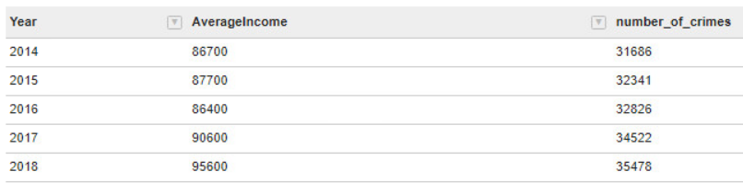
Table from Hive
Average Income View
Joined Table

Slide 19
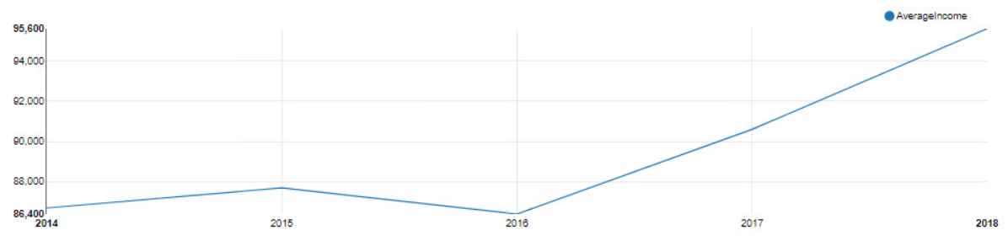
The data shows that the average income increased over the years, while the number of crimes also increased, but this does not necessarily mean that there is a direct causal relationship between the two variables.
Number of Crimes vs Year
Average Income vs Year

Slide 20
Thanks

